Slide 1

Task 1
Type the code below into Python and press enter:
temp = float(input("What is the temperature? "))
if temp > 25
print("Wear shorts. ")
else:
print(Wear trousers.)
Now fix the errors:
Place a screenshot of your fixed code here.

Slide 2
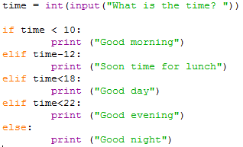
Task 2
Type the code below into Python and press enter:
Now fix the errors:
time = inf(input("What is the time? "))
if time < 10:
print ("Good morning“)
elif time-12:
print (Soon time for lunch“)
elit time<18:
print ("Good day“)
elif time<22:
print ("Good evening“)
else:
print "Good night
Place a screenshot of your fixed code here:

